Slide 1
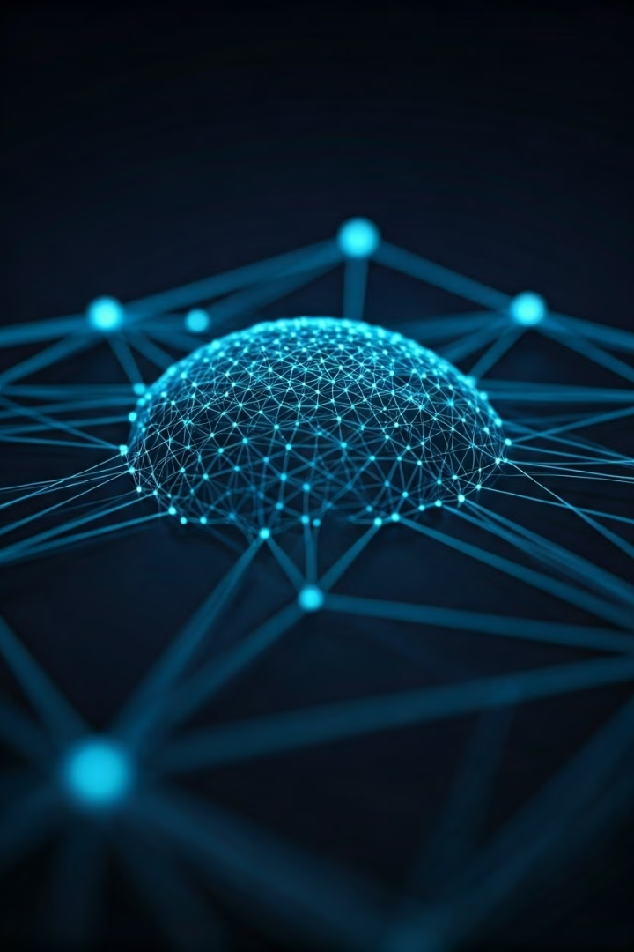

Knowledge Graphs: Empowering Generative AI
Knowledge graphs are revolutionizing how generative AI models answer questions. By leveraging structured, interconnected data, these graphs provide rich context for AI, enhancing accuracy and reducing hallucinations. This presentation explores how knowledge graphs and Retrieval Augmented Generation (RAG) are transforming AI interactions.
by Joel Kalonji

Slide 2

Retrieval Augmented Generation (RAG)
1
Query Input
User submits a question to the AI model.
2
Knowledge Retrieval
Relevant information is fetched from a knowledge base.
3
Context Integration
Retrieved information is provided to the LLM as context.
4
Response Generation
LLM generates an accurate, informed response based on the enriched context.

Slide 3
Graph RAG: Leveraging Knowledge Graphs
Structure
Connectivity
Flexibility
Knowledge graphs represent data as entities and relationships, forming a rich network of information.
Interconnected nature allows for deeper context and more comprehensive understanding of queried topics.
Graphs can easily incorporate new information, adapting to changing knowledge landscapes.

Slide 4
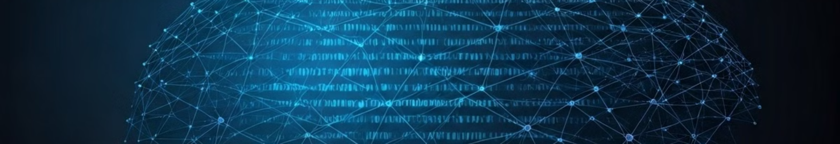




NLQ Pattern: Translating Questions to Graph Queries
Natural Language Input
LLM Processing
Query Generation
Graph Exploration
AI model interprets the question using graph schema context.
LLM constructs a precise graph query matching the user's intent.
Query executed on knowledge graph to retrieve relevant information.
User asks a question in everyday language.

Slide 5
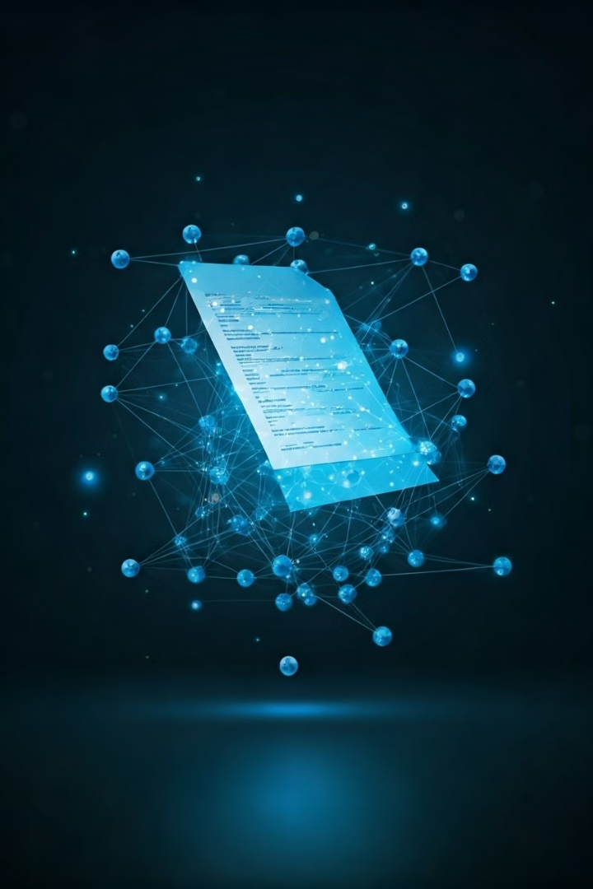
KG Gen Pattern: Building Graphs from Text
1
Text Analysis
LLM processes unstructured text, identifying key entities and relationships.
2
Entity Extraction
Important concepts and objects are isolated from the text.
3
Relationship Mapping
Connections between entities are established based on textual context.
4
Graph Construction
Extracted information is used to build or expand a knowledge graph.

Slide 6
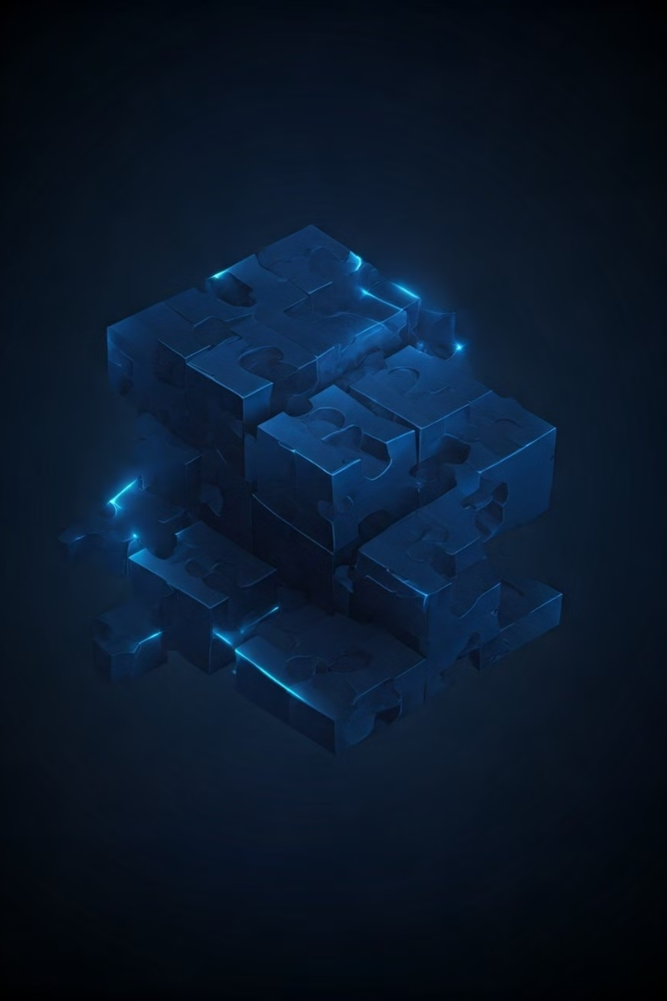
Connected Chunks: Managing Large-Scale Text
Text Segmentation
Vector Embedding
Large documents are divided into smaller, manageable chunks for processing.
Each chunk is converted into a high-dimensional vector representation.
Similarity Search
Context Assembly
Vector embeddings enable efficient search for relevant text segments.
Related chunks are combined to provide comprehensive context for AI responses.

Slide 7

Case Study: Investment Banking Deal Research
Use Case
Deal research chatbot for investment bankers
Graph Content
Companies, deals, roles, document metadata
Query Example
"Summarize deals where the buyer is Amazon or another FANG company"
Benefits
Quick access to complex deal information, improved decision-making

Slide 8
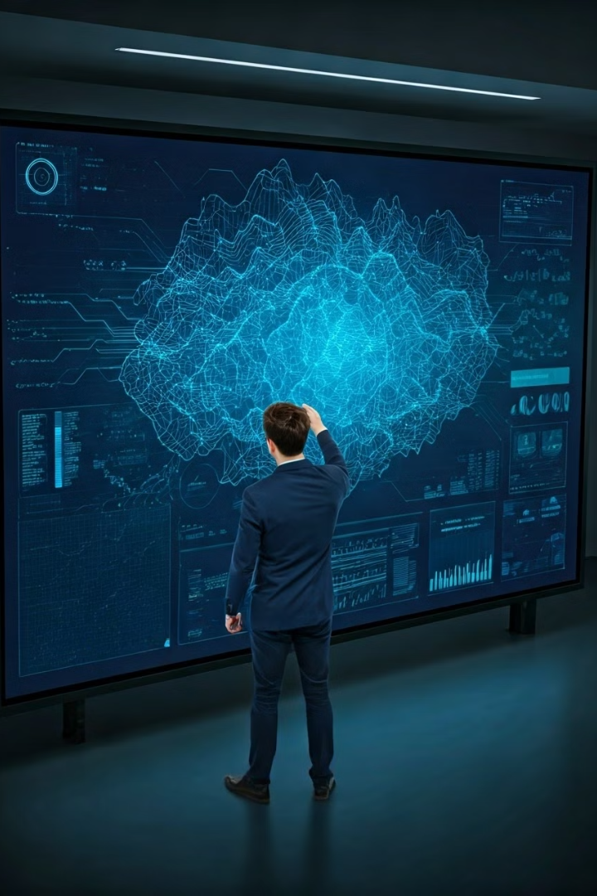




Implementing Graph RAG: Best Practices
Combine Patterns
Incorporate Taxonomy
Integrate multiple Graph RAG patterns for comprehensive solutions.
Use structured classification systems to enhance graph organization and searchability.
Develop Ontologies
Continuous Refinement
Create formal representations of domain knowledge to improve graph context.
Regularly update and expand your knowledge graph with new information.

